Slide 1

Landspítali – University Hospital

Slide 2
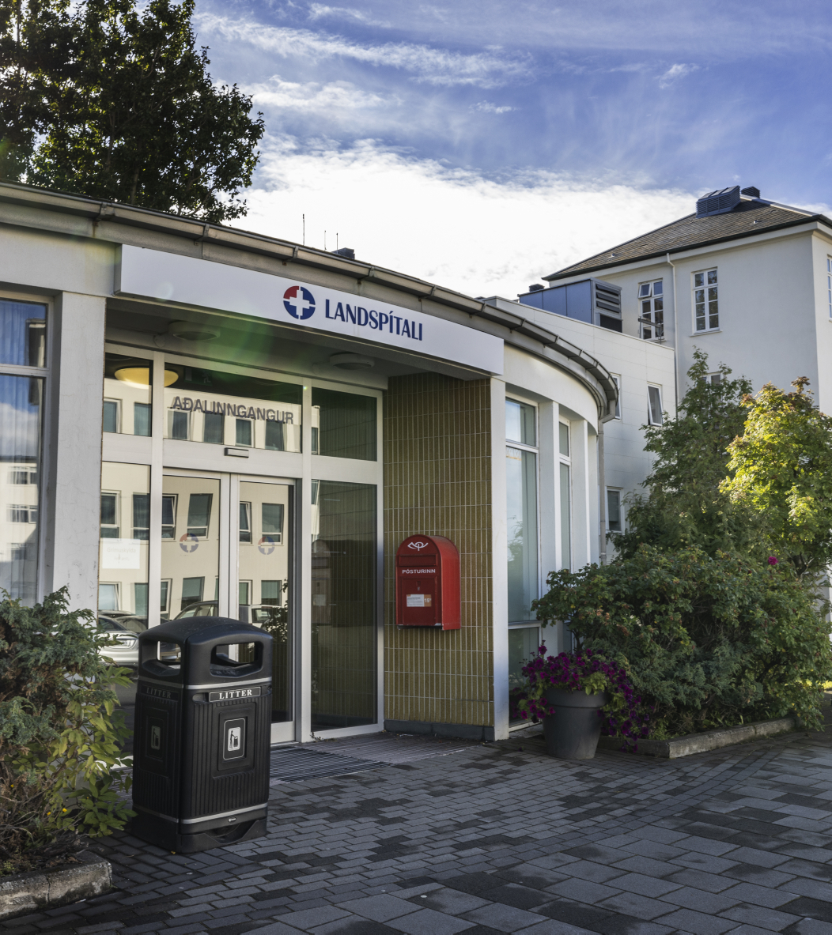
Agenda
Health care in Iceland
Landspítali
  Organization
  Operations
  New Hospital Building

Slide 3
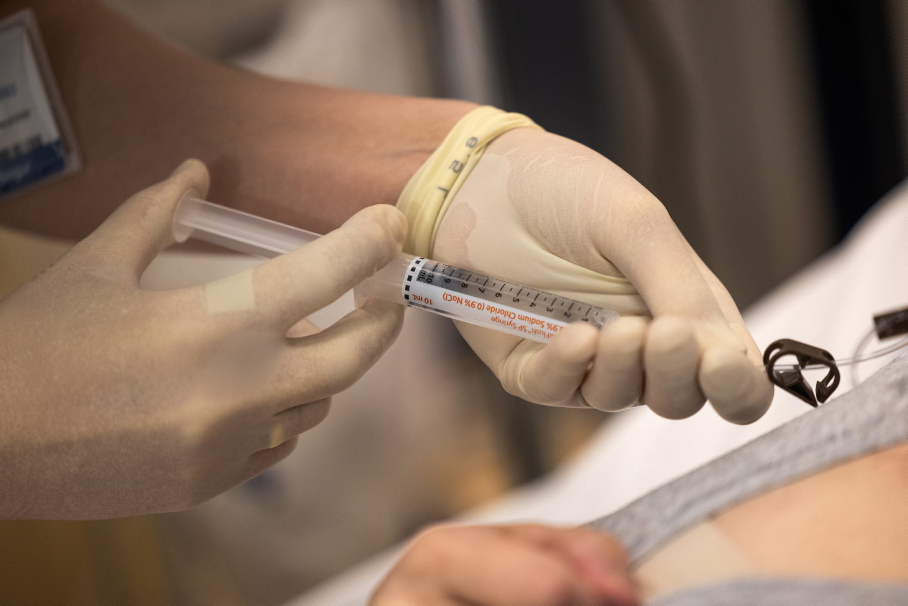
Health care in Iceland

Slide 4
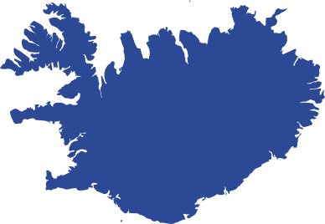
The Icelandic Health care system
Icelandic population
384.000 (Jan. 2024)
247.000 in the capital area
Health sector counts for 9,3% of GDP
Financing of health services
84,7% through taxes and 15,3% by individuals
Good clinical results in comparison to other OECD nations
Good access to services

Slide 5
Low cancer incidence and mortality Iceland vs. OECD
Cancer mortality rates by sex, 2021 (or nearest year)
Source: OECD Health Statistics 2023

Slide 6
Low heart attack and Ischaemic heart disease mortality
Iceland vs. OECD
Heart attacks and other ischaemic heart disease mortality, 2021 and 2011 (or nearest year)
Source: OECD Health Statistics 2023

Slide 7
Low stroke mortality
Iceland vs. OECD
Stroke mortality, 2021 and 2011 (or nearest year)
Source: OECD Health Statistics 2023

Slide 8
Low Covid-19 mortality
COVID-19 mortality for 2020-2022
Sources: COVID-19 deaths from OECD Health Statistics 2023; population data from UNWPP 2022.

Slide 9
The Icelandic Health Care System
One university hospital
One teaching hospital
Several small rural hospitals
  primary care
  nursing homes
Primary health care centres
Private practices
Financing
  National health insurance
  Fixed budgets
  Fee for service, private practices
EHR and diverse clinical information systems
OeBS system for financial and HR processes

Slide 10
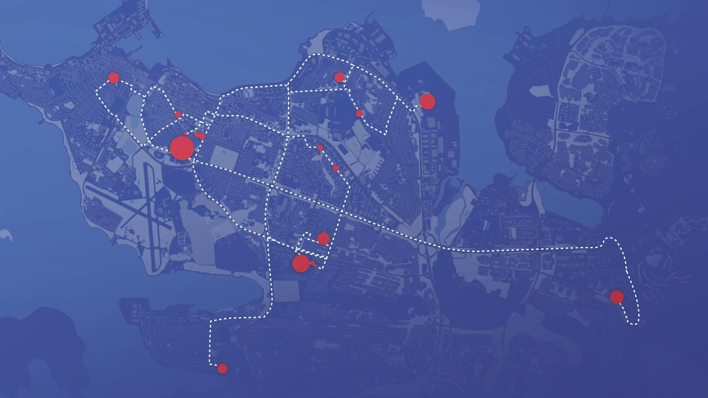
Landspitali
The only university hospital and largest organization in Iceland
6.600 employees
and 2.000 students
in 100 buildings
on 20 sites in the capital area of Reykjavík
New CEO in 2008, 2010, 2014 and 2022
Major reorganization in 2009, 2015, 2019 and 2023
Created by a series of mergers In 1996, 2000 and 2011

Slide 11
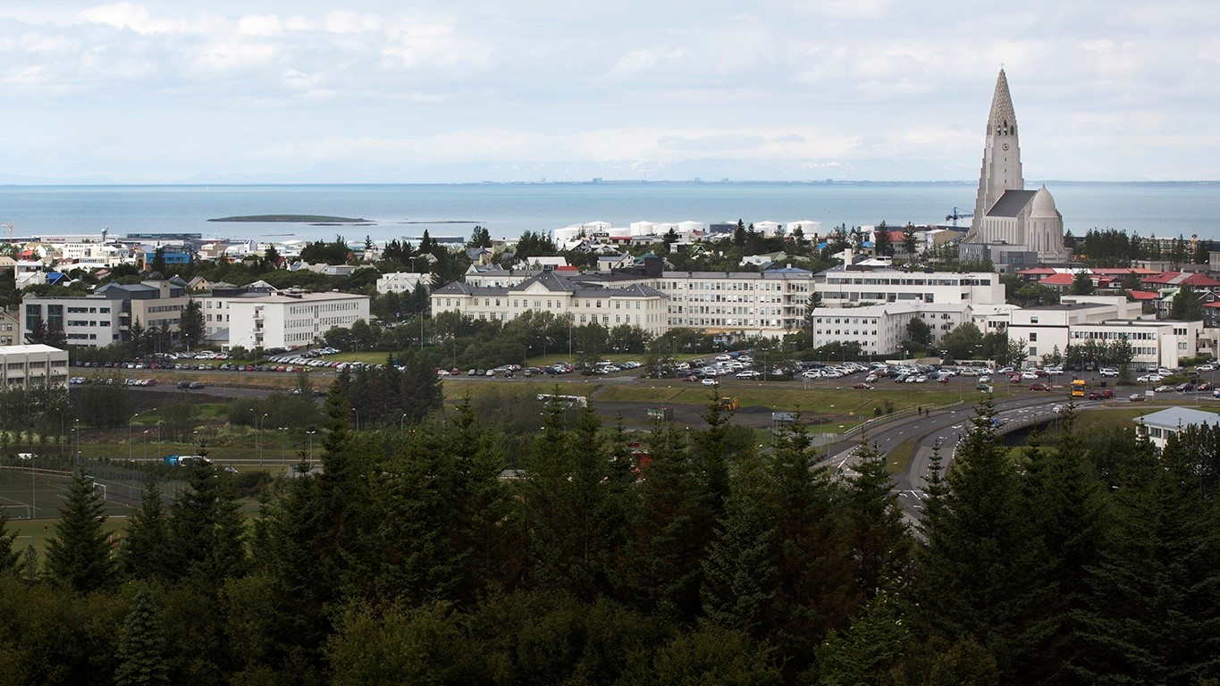
Landspitali - Hringbraut

Slide 12
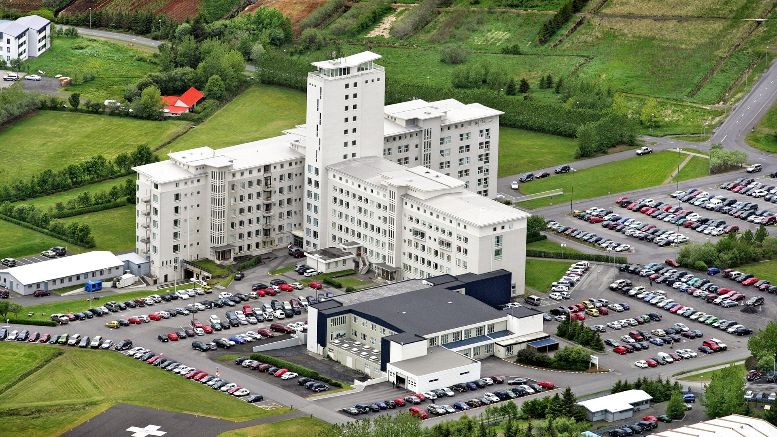
Landspitali - Fossvogur

Slide 13
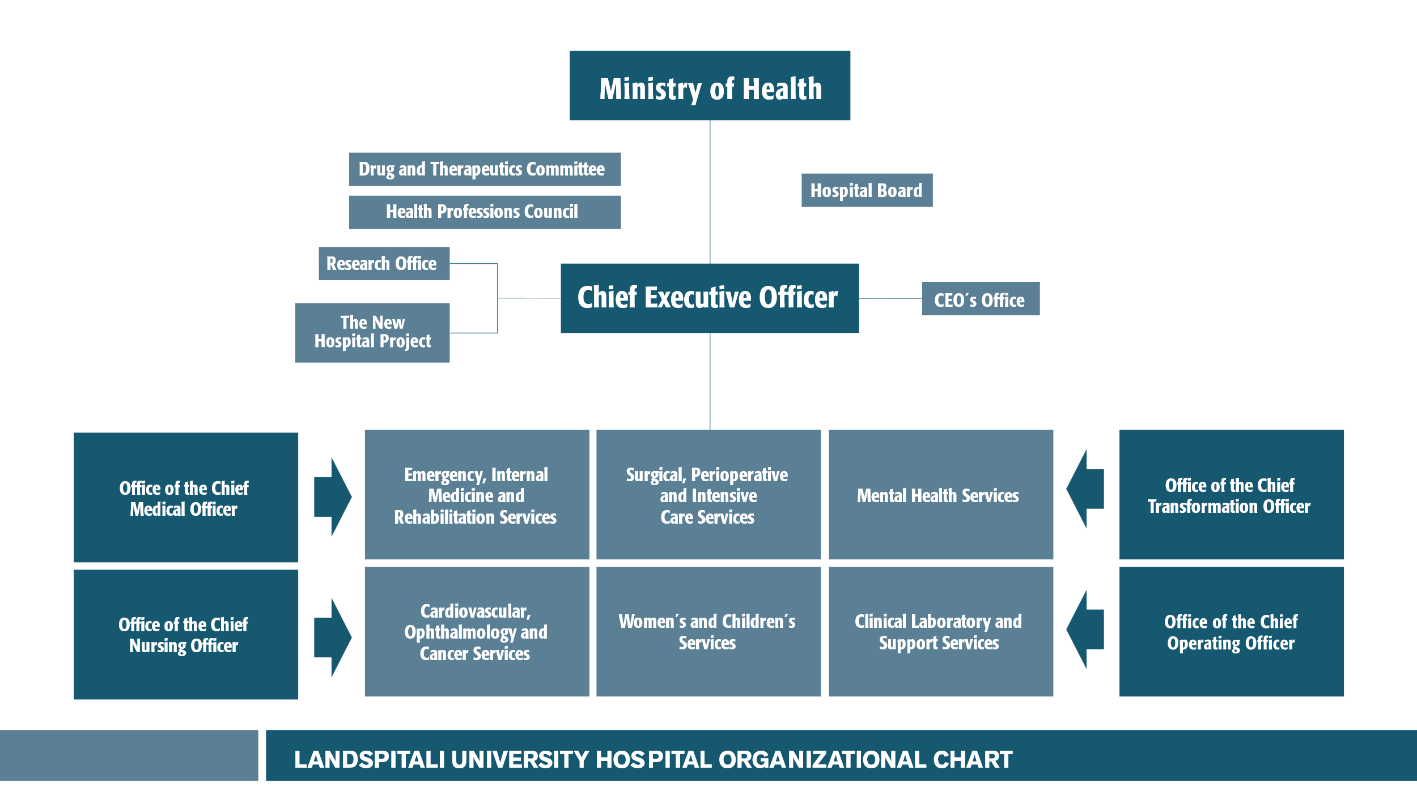

Slide 14
Landspitali
40 medical specialities
  Many subspecialities
Medical speciality training abroad
  Mostly in Sweden, Norway, USA, UK, The Netherlands
Very few patients sent abroad for treatments
  Some heart surgery, some stem cell treatments, PET and solid organ transplants (excl. renal transplants)
Good clinical results
A third of the population served in 2023
Approximately 1.700 students per year3 Budget approx 110,1 billion ISK
  801 million USD
  738 million EUR

Slide 15
Clinical service
94.200
emergency visits
521.700
outpatient services
27.400
admissions
624
hospital beds
4,8
days average length of stay
14.600
surgical procedures
3.166
births

Slide 16
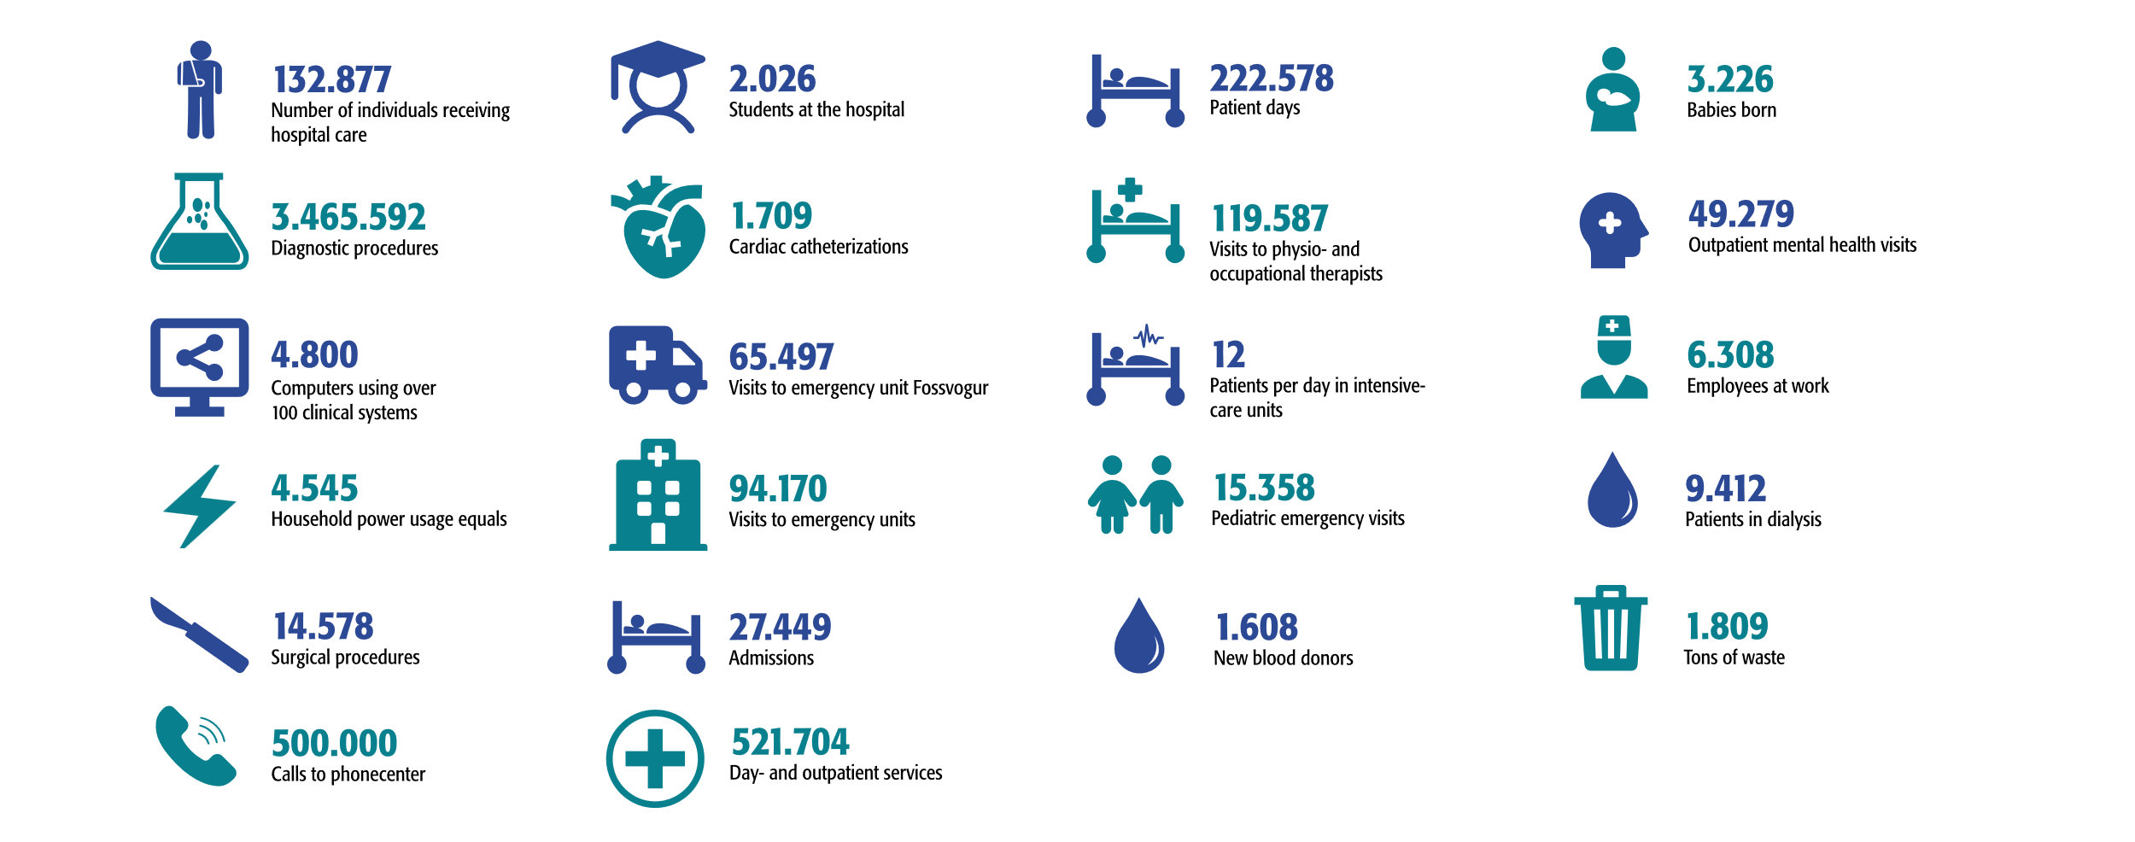
The year 2023 at Landspitali

Slide 17
A typical day at Landspitali
609 inpatients
2.087 day- and outpatient services
75 new admissions
9.495 laboratory tests
469 visits to physio- and occupational therapists
258 emergency unit visits
40 surgical procedures
9 babies born
42 pediatric emergency visits
7 cardiac catheterizations
31 patients in dialysis
197 outpatient mental health services
12 patients in intensive-care units
3.700 employees at work
5 tons of waste, 1,8 tons recycled

Slide 18
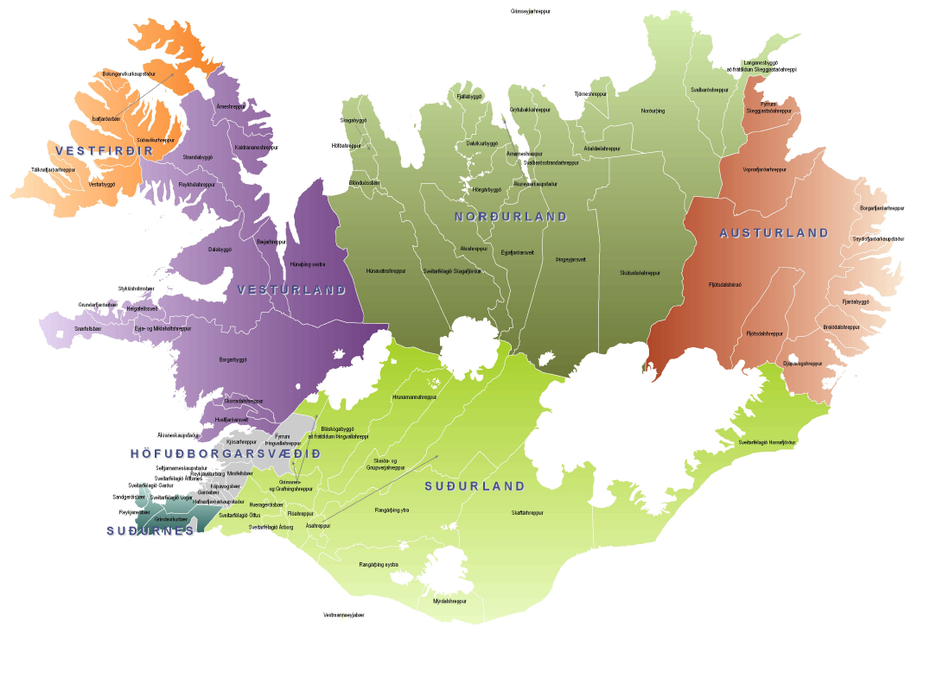
Patients seeking health care service at landspitali come from all health districts in the country
Reykjavík

Slide 19

Number of individuals receiving hospital care at Landspítali
Approx. 30 % of Icelanders every year

Slide 20
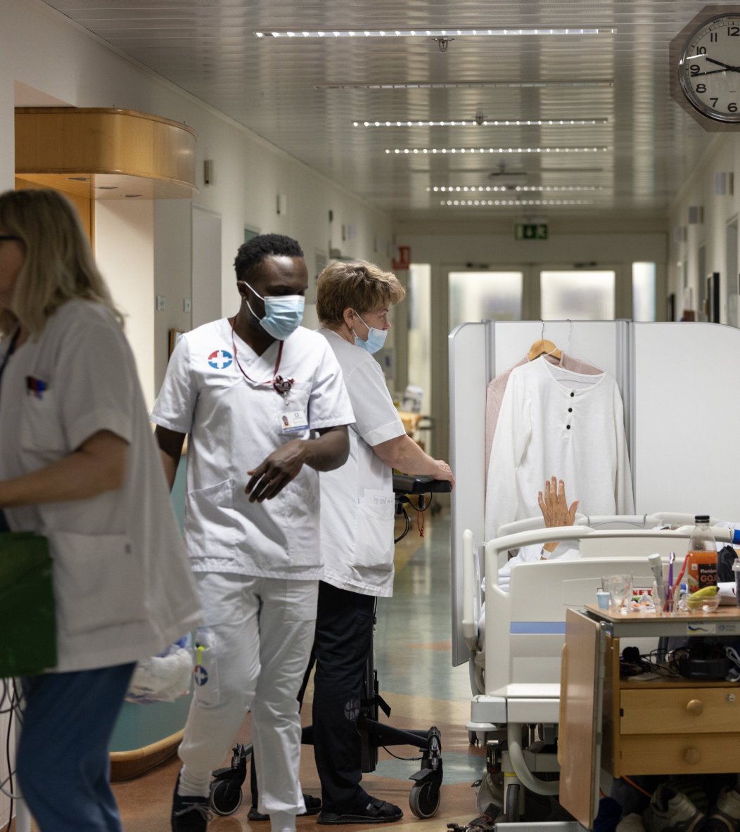
Number of visits to emergency units

Slide 21
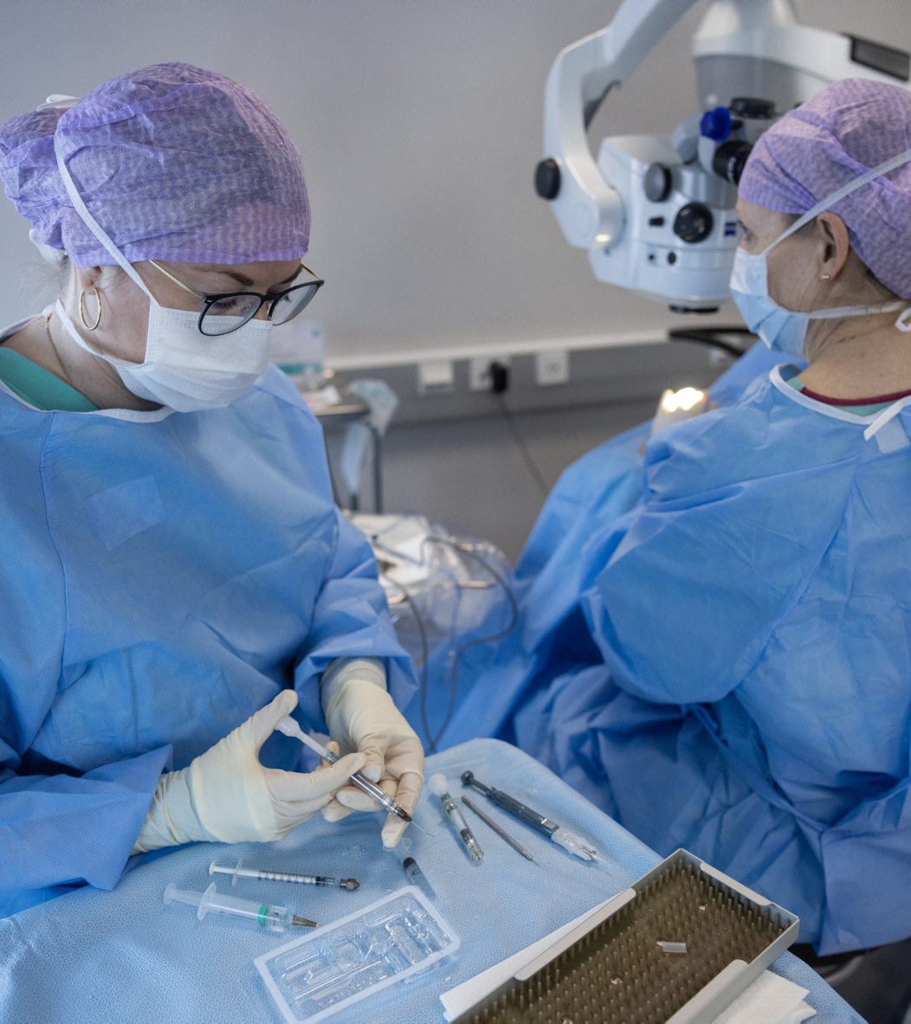
Surgery

Slide 22
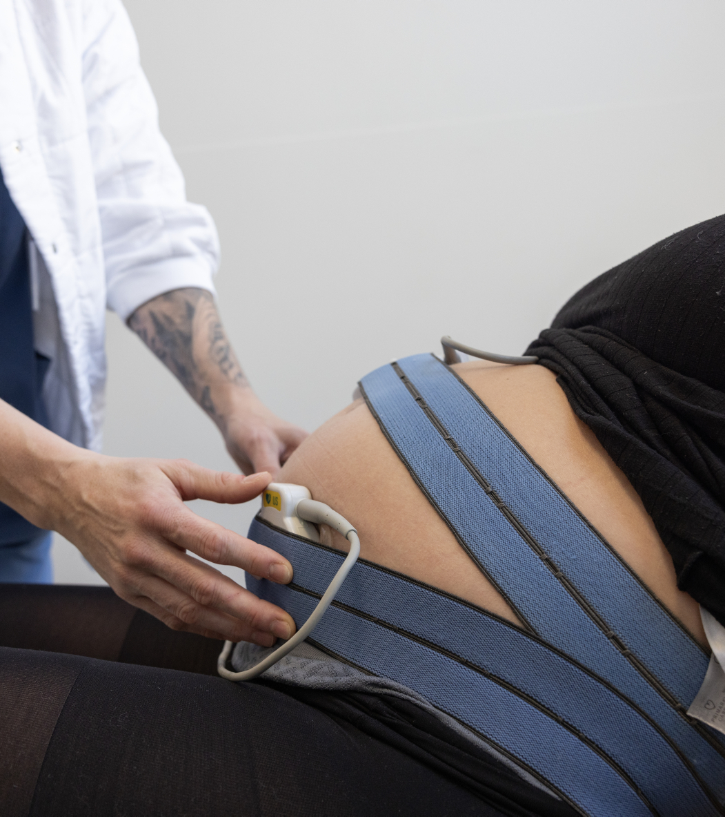
Over 70% of all births in Iceland occur at Landspitali

Slide 23
Inpatients; main Diagnostic Categories
(of the DRG system)

Slide 24
Quality indicators: Births

Slide 25
Quality indicators: Neurology
Stroke, mortality within 30 days from admission

Slide 26
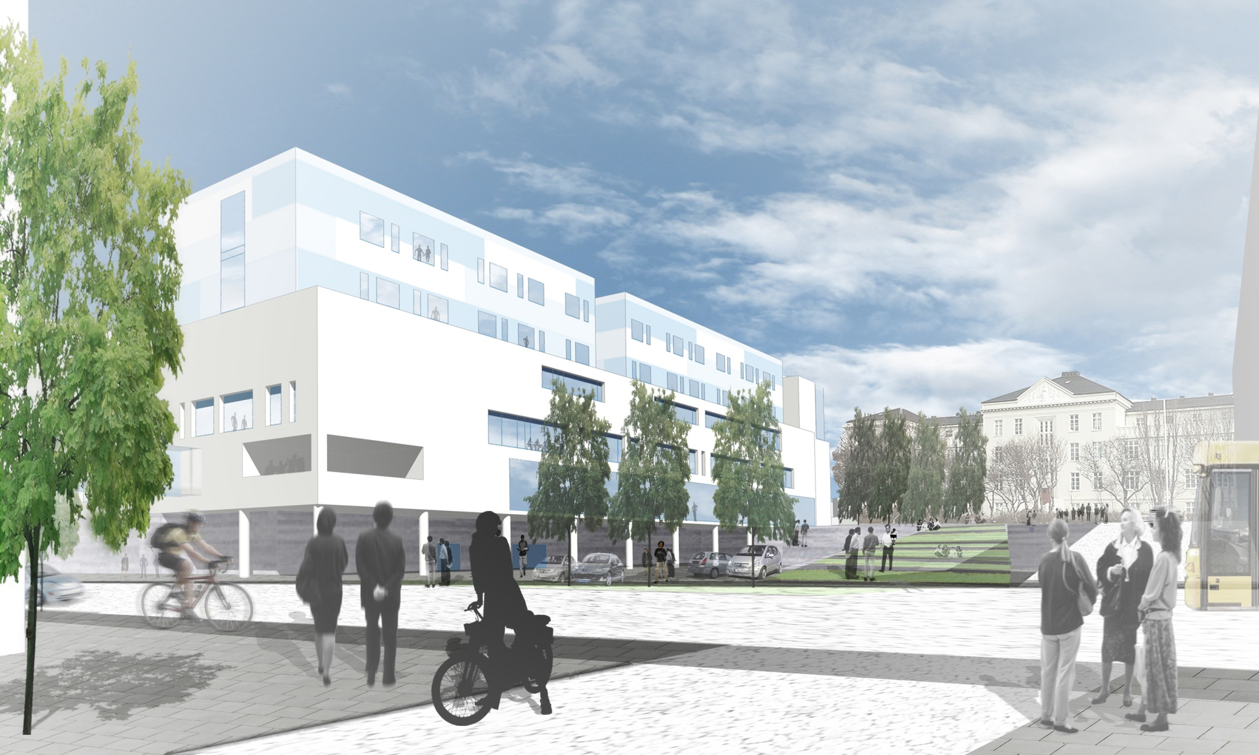
New hospital building

Slide 27
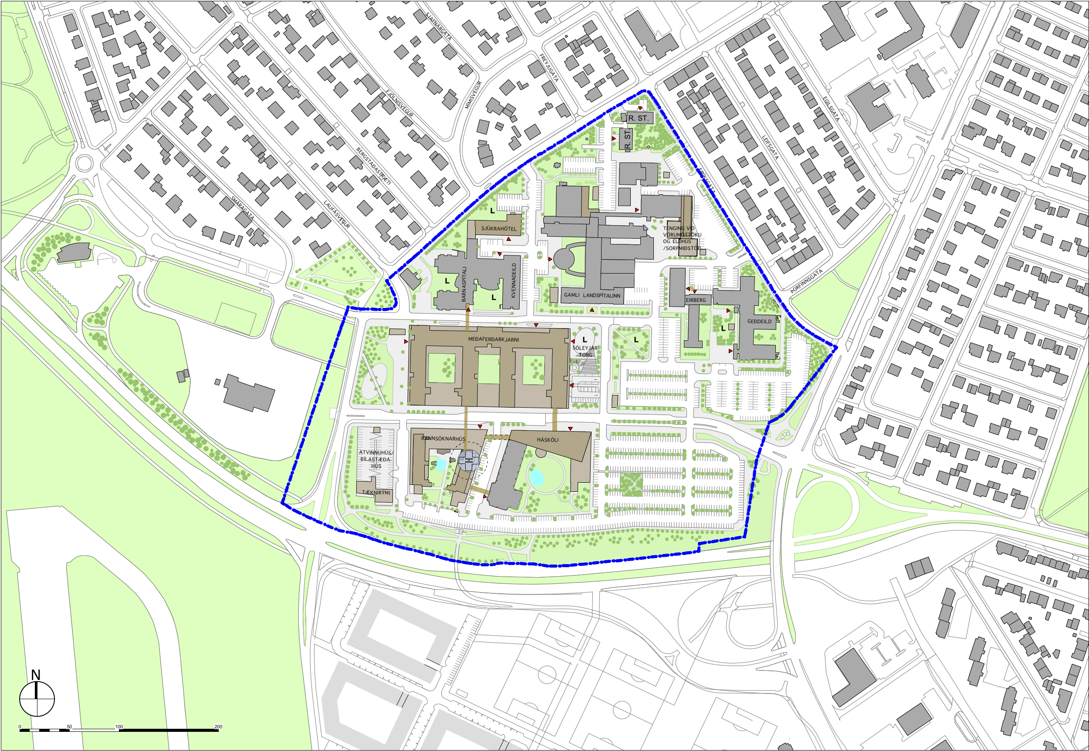
Landspitali – Phase 1

Slide 28
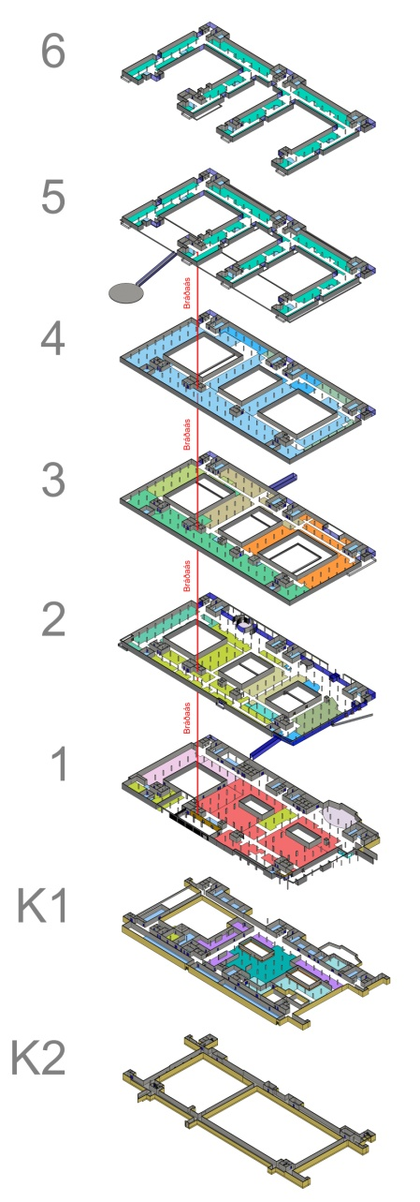
Landspítali – Acute Core/Treatment areas/Bed Wards – 58.500 m²
Bed Wards
Bed Wards
Technical areas / offices
Pre/post, Surgery,
Catherization,
intensive care
Infectious diseases
Diagnostic imaging
Lobby, Cantine
Emerg. Departm.
Pharmacy
PET production
Sterilization
Wardrobes
PET cyclotron
Technical ducts

Slide 29
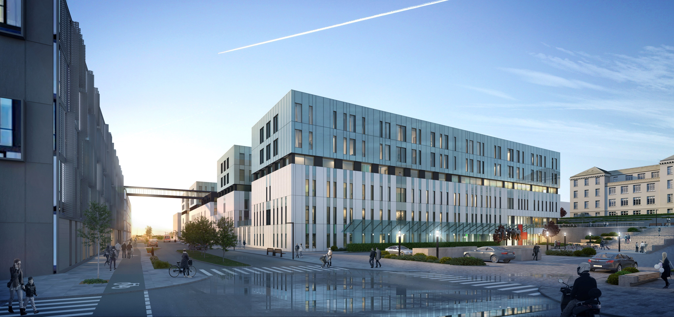

Slide 30
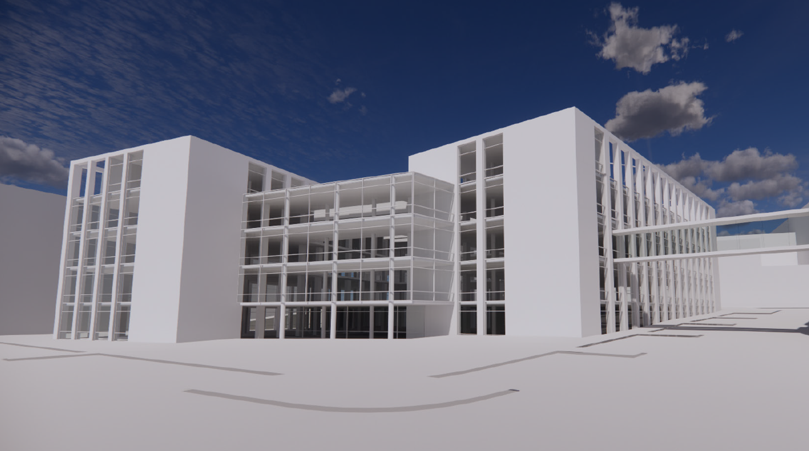

Slide 31
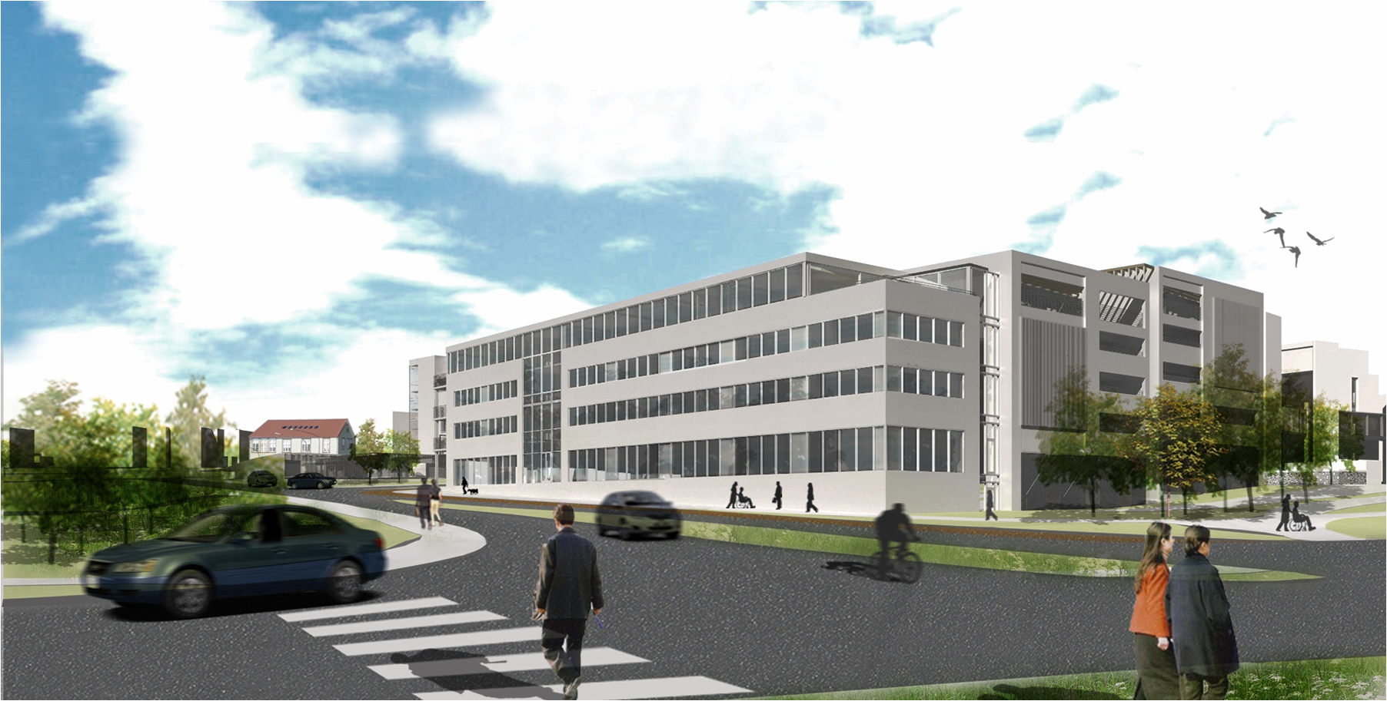

Slide 32
